Slide 1
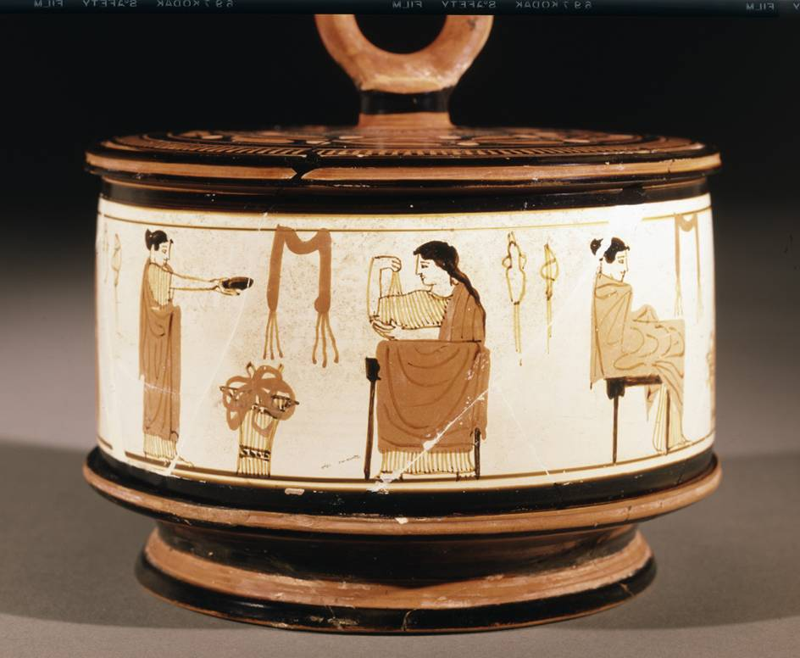
Women in the Household

Slide 2
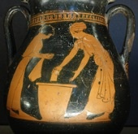
Housework and Collecting Water
Washing clothes?
At the fountain
Cooking

Slide 3
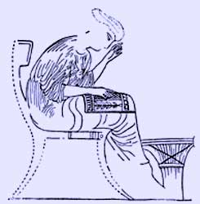
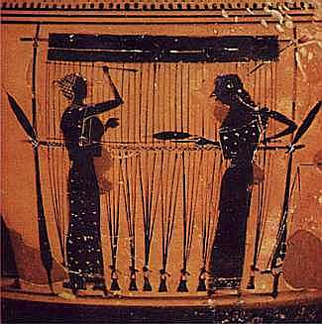
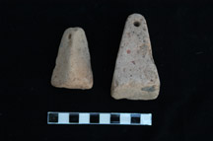
Woolwork
preparing the wool
spinning
weaving
epinetron
spindle whorl
loomweight

Slide 4
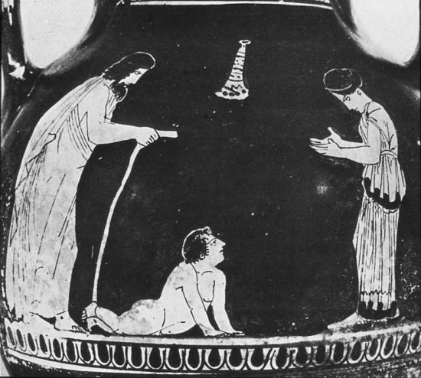
Childcare

Slide 5
Make-up and Jewellery
Eros – god of love
mirror
necklace

Slide 6
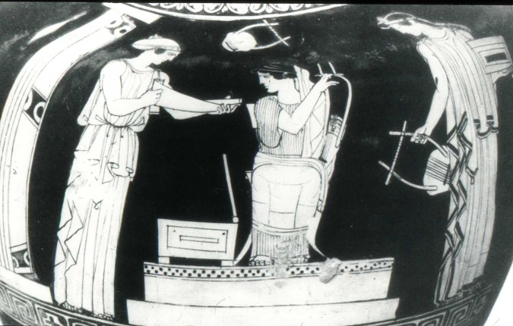
Reading and Music

Slide 7
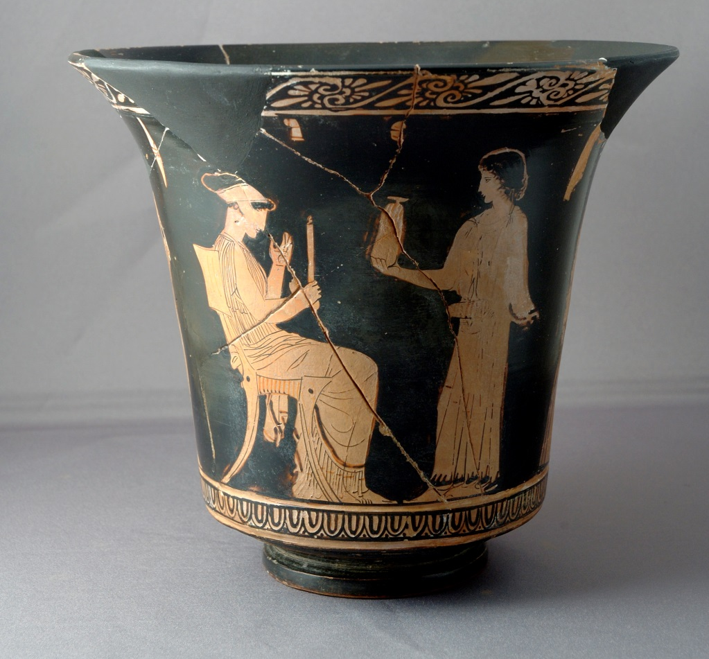
Newcastle Shefton Collection 853
Red-figure pottery kalathos (basket-shaped container)
Made in Athens c.440 BC
Height 15.2cm

Slide 8
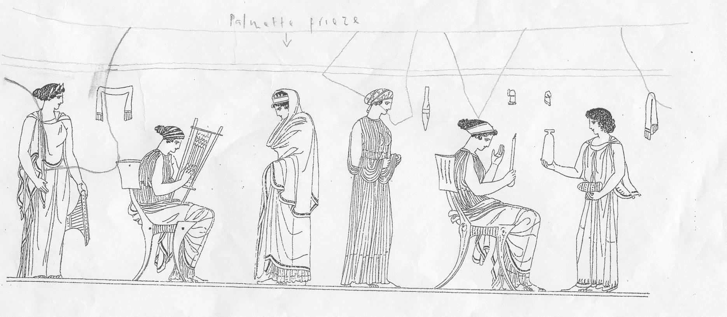
Reading a picture = Iconography
Wool basket and small weaving frame

Slide 9
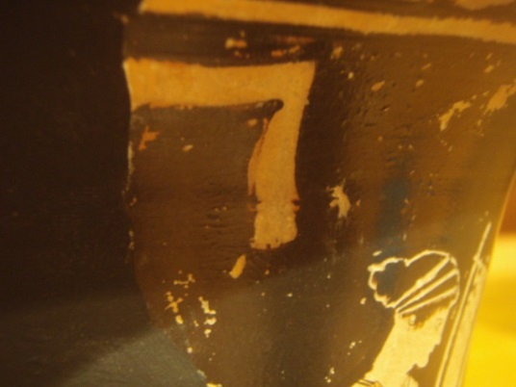
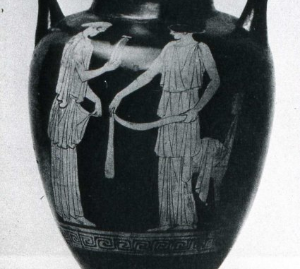
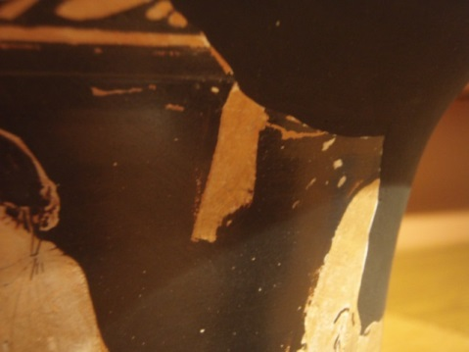
Belts or hairbands

Slide 10
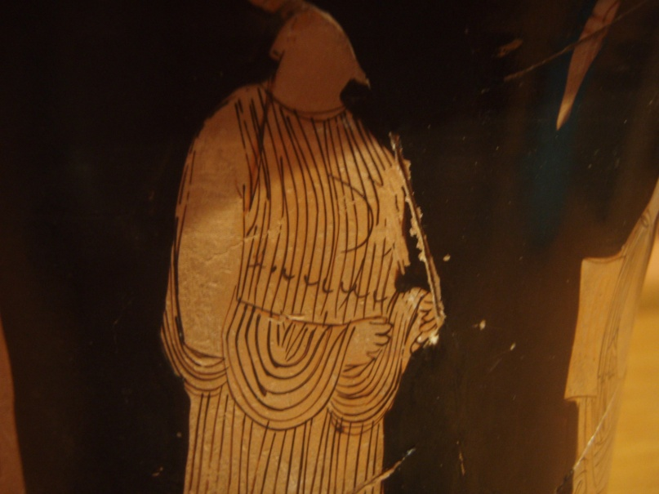
Veil Tying belt

Slide 11
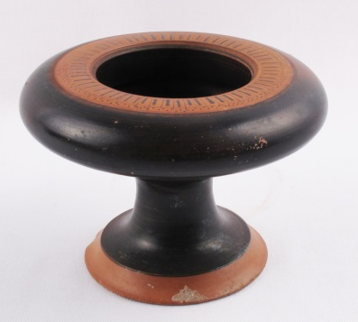
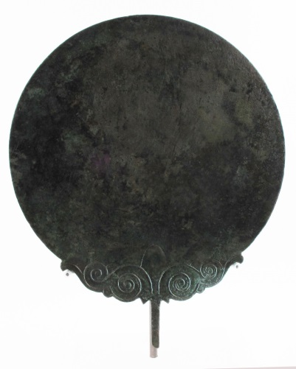
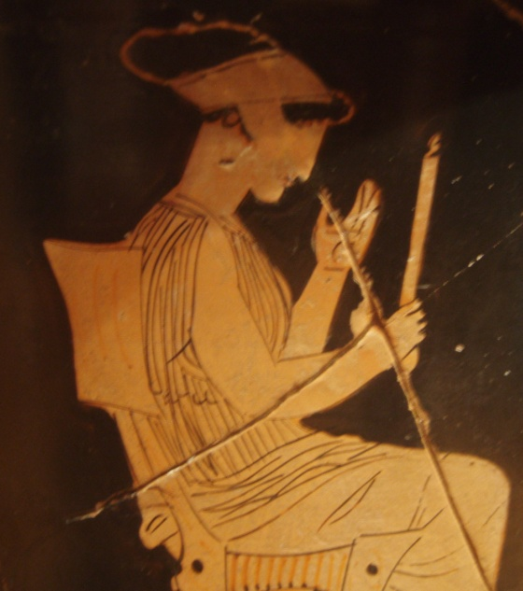
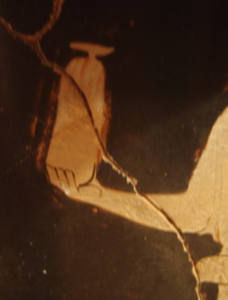
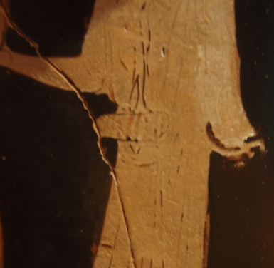
Perfume pots
mirror

Slide 12
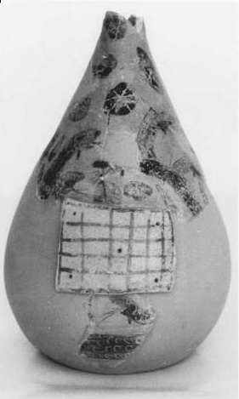
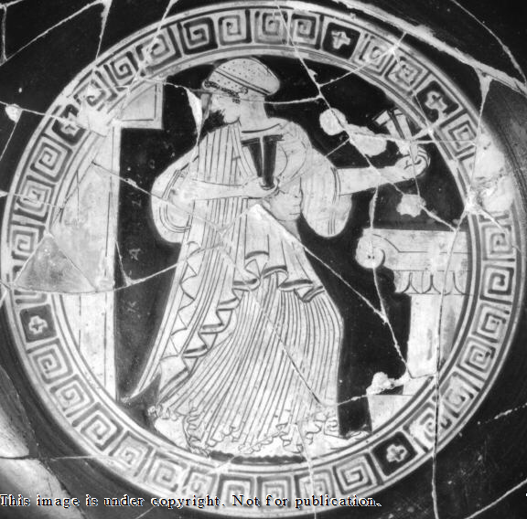
Phormiskos – container for knucklebones
Castanets

